Slide 1
Boikini
University Of Dhaka
CSE3112: Software Engineering Lab
Shahnaz Sharmin (07)
Anika Tabassum (61)

Slide 2
Introduction
Boikini is an online book shop where people can buy books or pre-order
them. It provides a user-friendly platform for book lovers to explore,
purchase, and manage their books. Our project aims to provide a seamless
experience to book buyers and sellers.

Slide 3
Technology Stack
Frontend: HTML, CSS, JavaScript
Backend: Python
Payment Gateway: Bkash

Slide 4
Should we take a tour to our website?

Slide 5
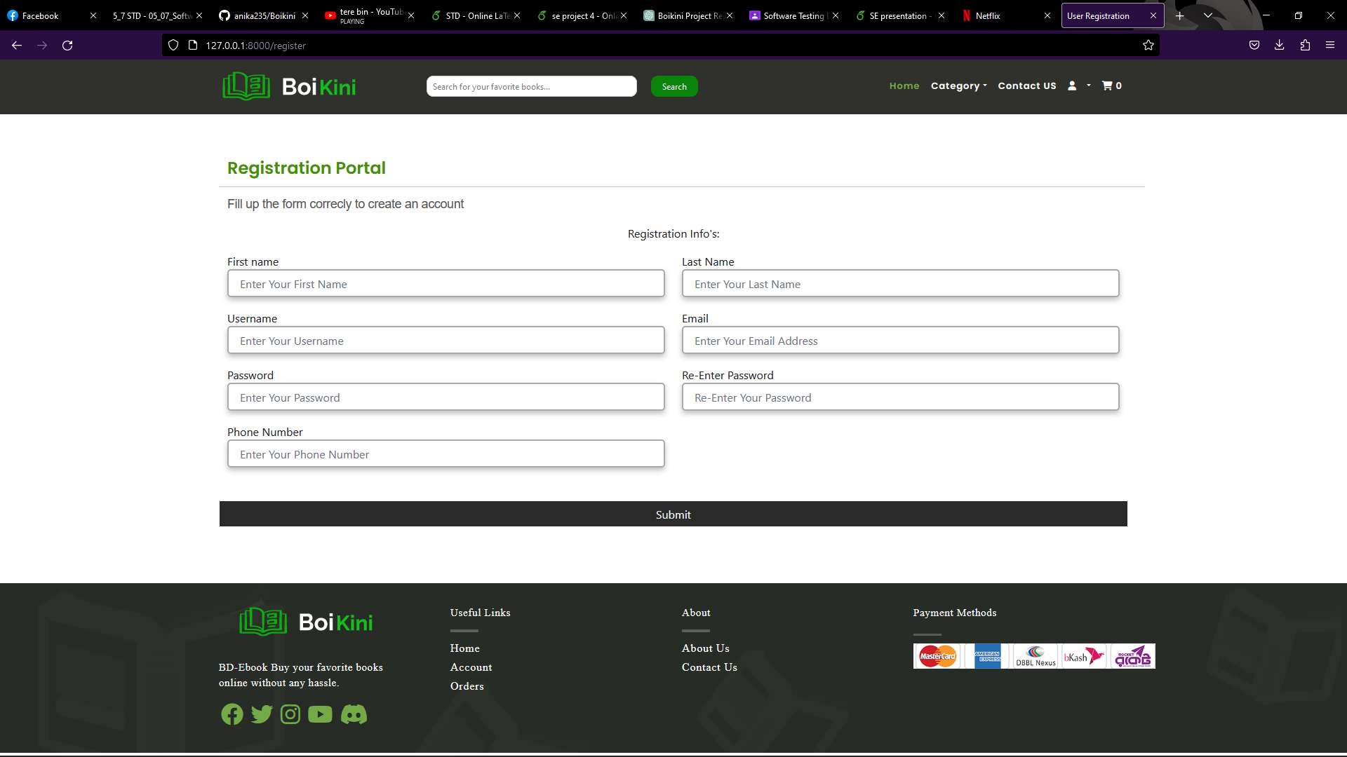
Registration
First , you need to register an account for you.

Slide 6
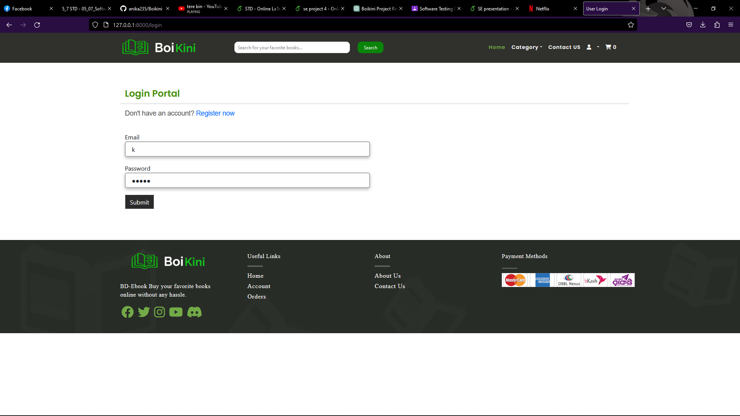
Login
Registration Done?
Now, you need to log in to the account to have the access of the books.

Slide 7
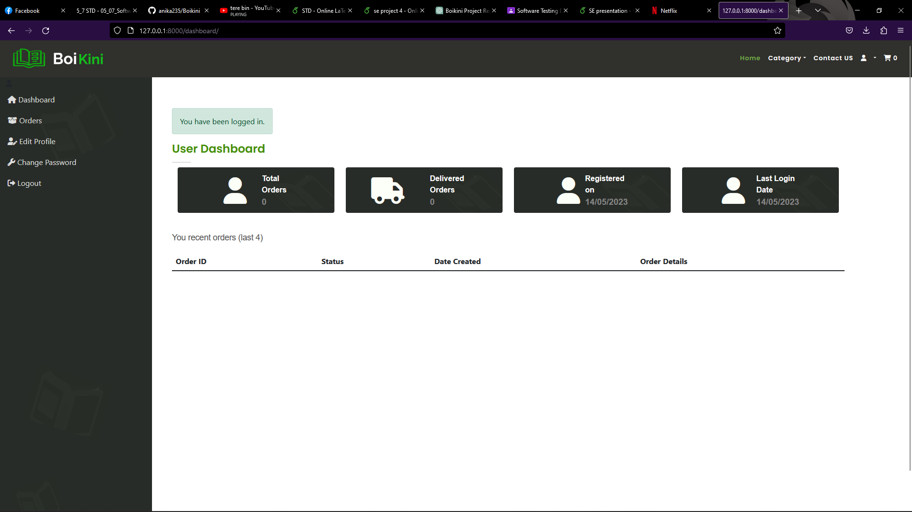
Dashboard
You have successfully logged in to the account.
Here you can see the dashboard with your orders , orders status, when you created your account and last login,

Slide 8
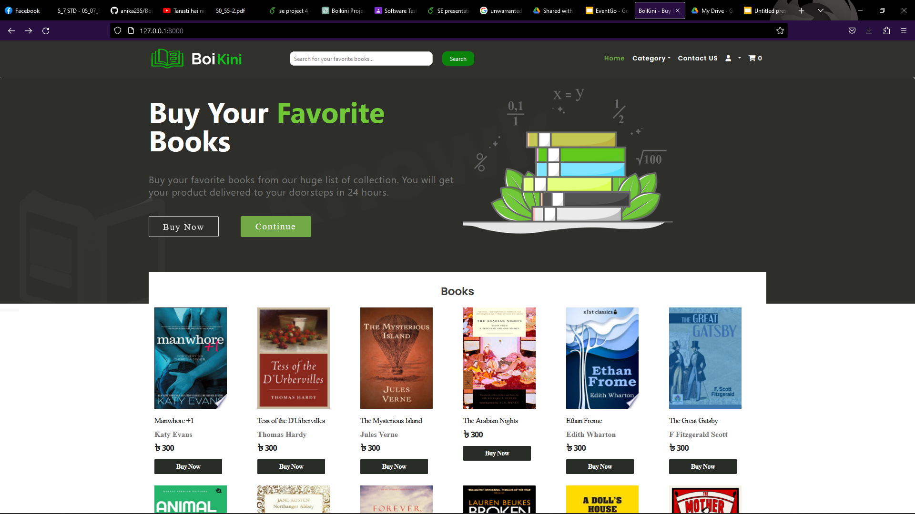
Home Page

Slide 9
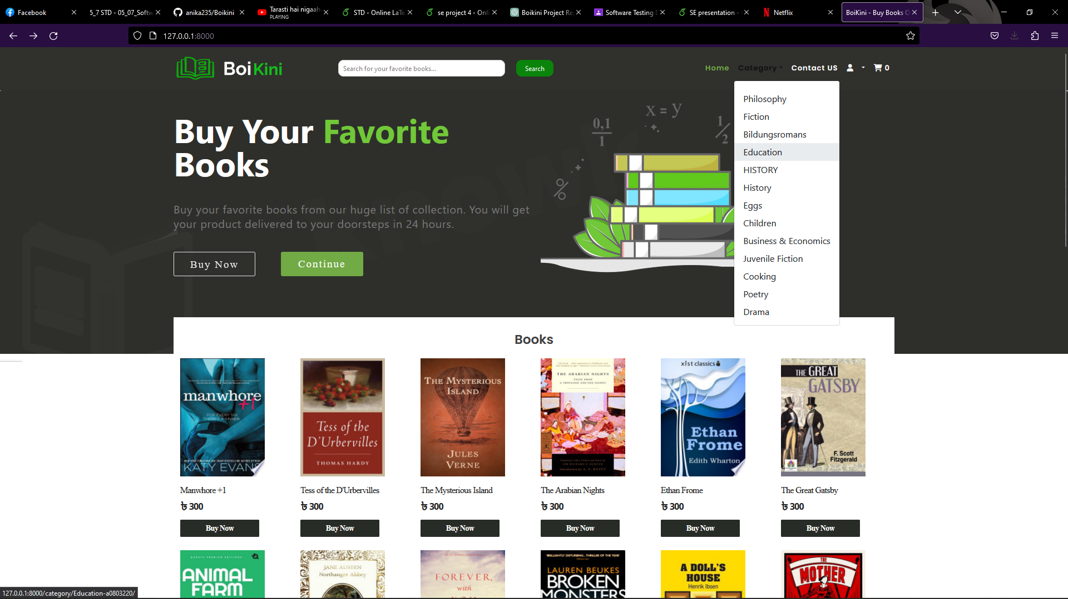
Category
You can choose your favorite category here

Slide 10
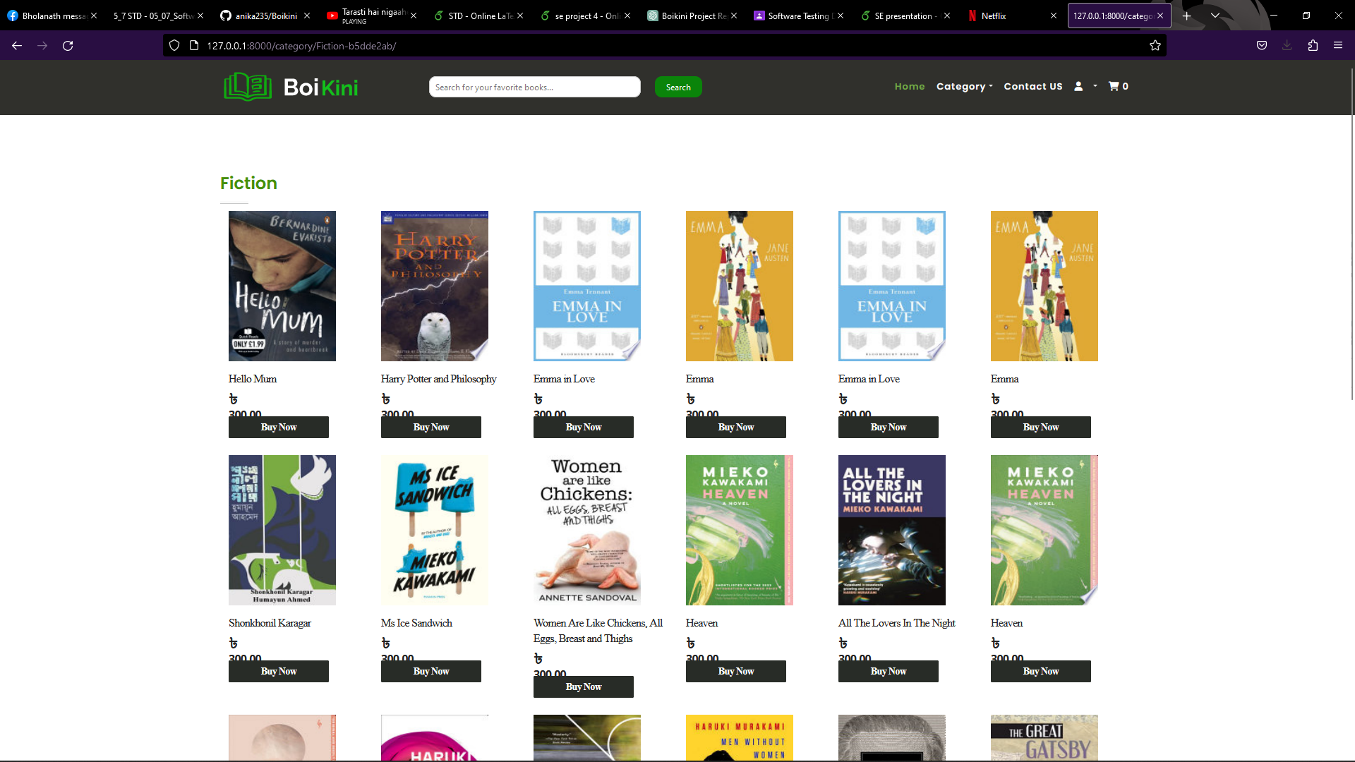
See!! I wanted fiction. And here got the fiction category.

Slide 11
So, Now let’s buy books?

Slide 12
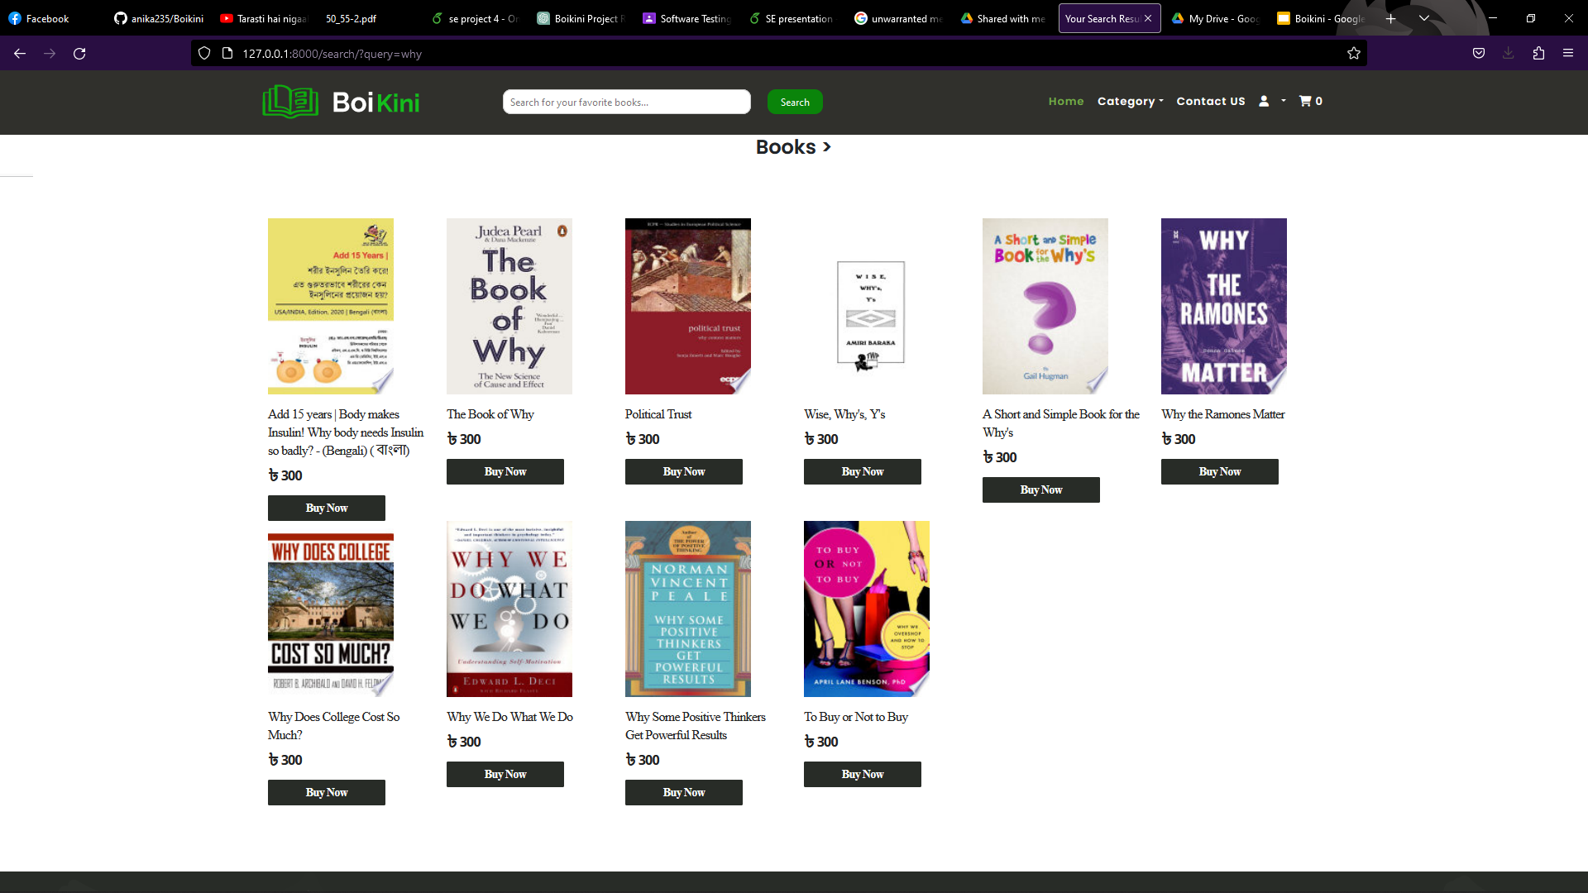
Search
I want to buy a book, called “To Buy or Not to Buy”. So I searched it here.

Slide 13
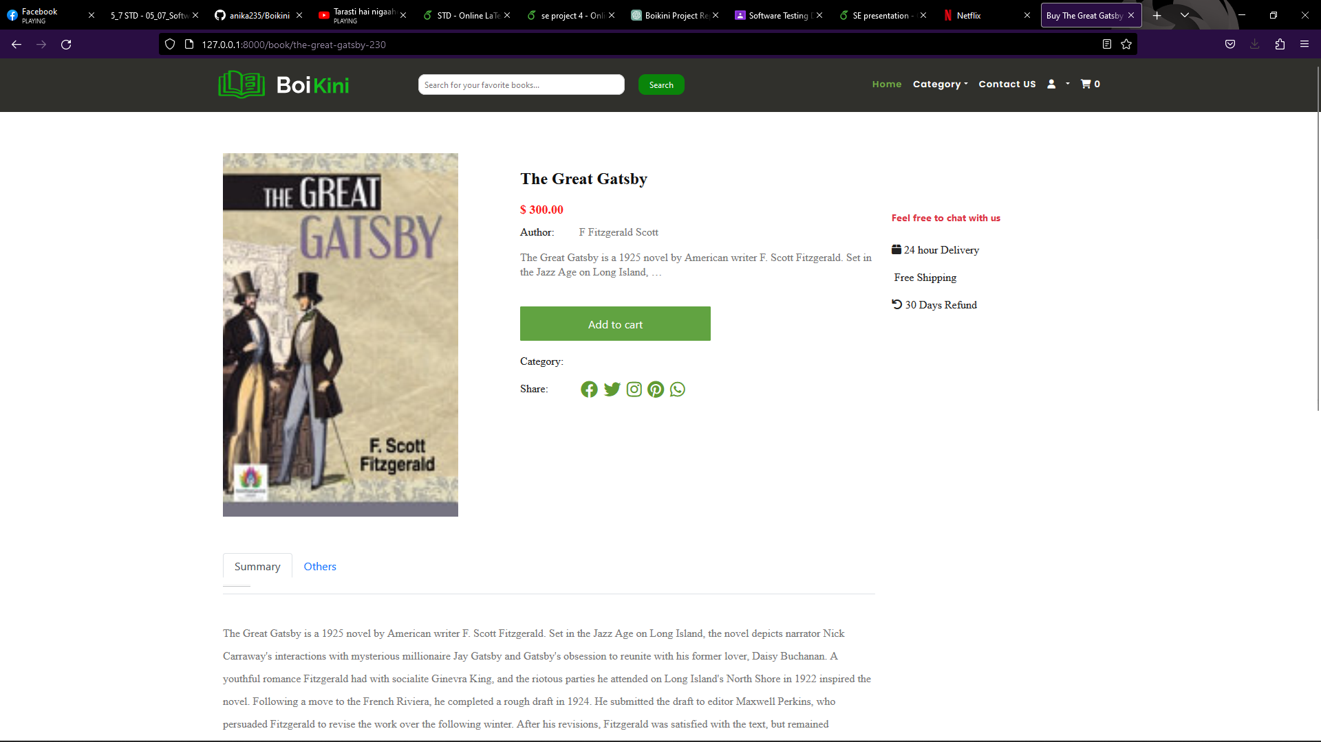
Book Details
You can see the book’s details, such that the author, price, summary, edition etc about the book.

Slide 14
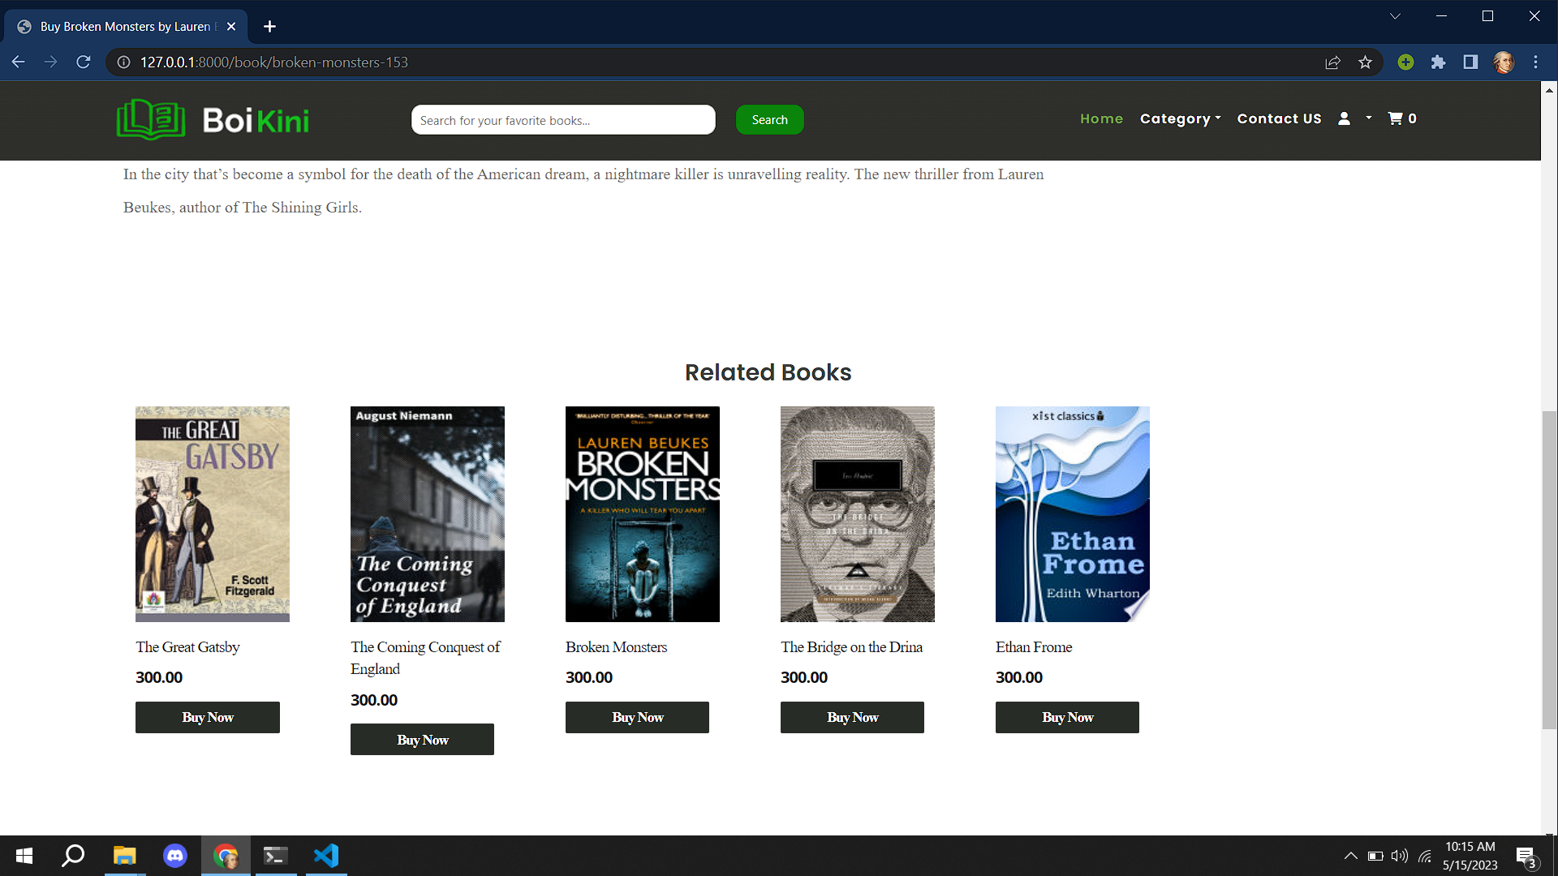
Related Books
You can see the related books here

Slide 15
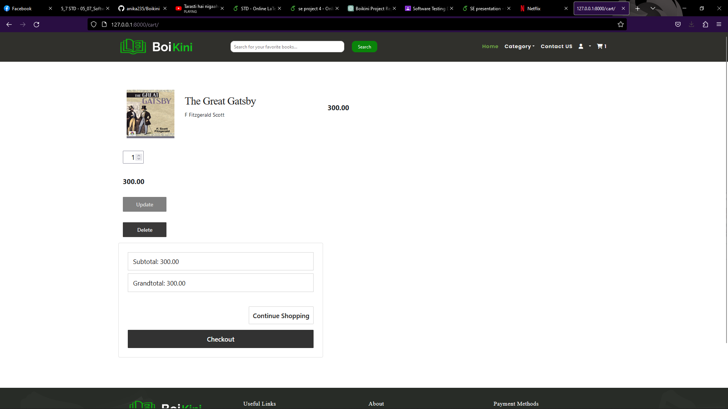
Cart View
I liked the book, that’s why I added that into the cart

Slide 16
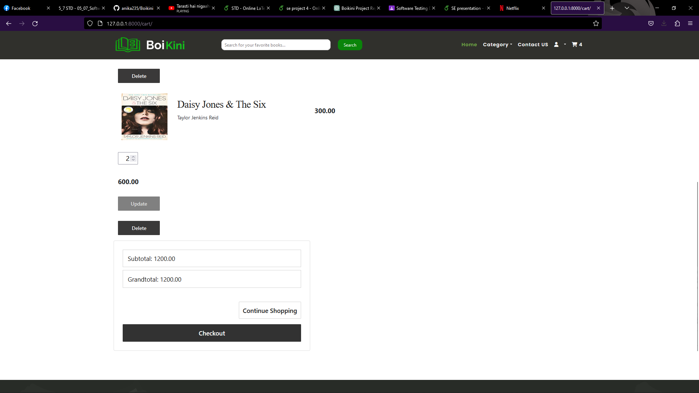
Modify Carts
You can add as many books as you want into the cart. And updates the cart items and the price. Also you can delete books from the cart. And proceed to the checkout section.

Slide 17
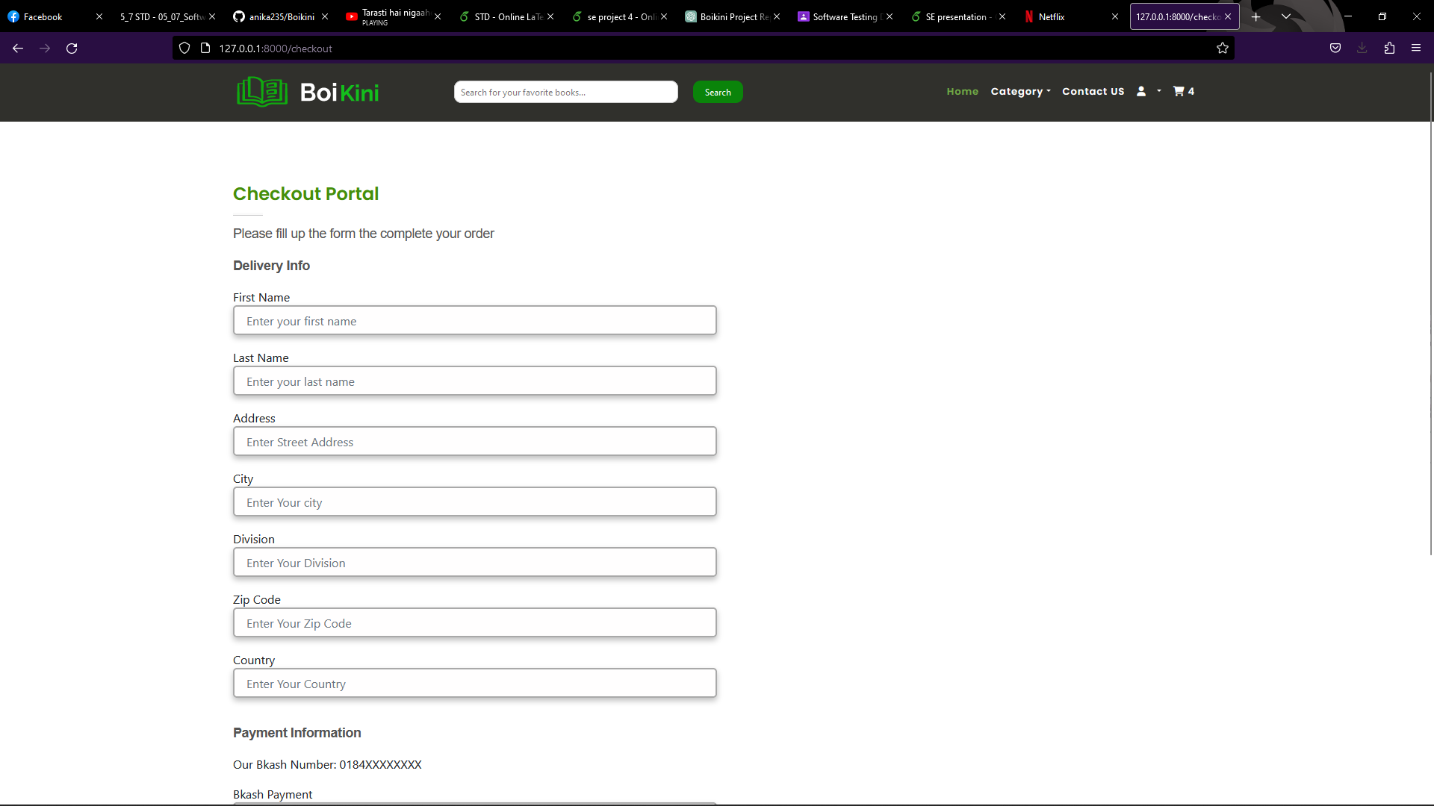
Checkout
You need to fill the delivery info sections to get your delivery correctly. And Need to enter your Bkash transaction number and confirm the checkout.

Slide 18
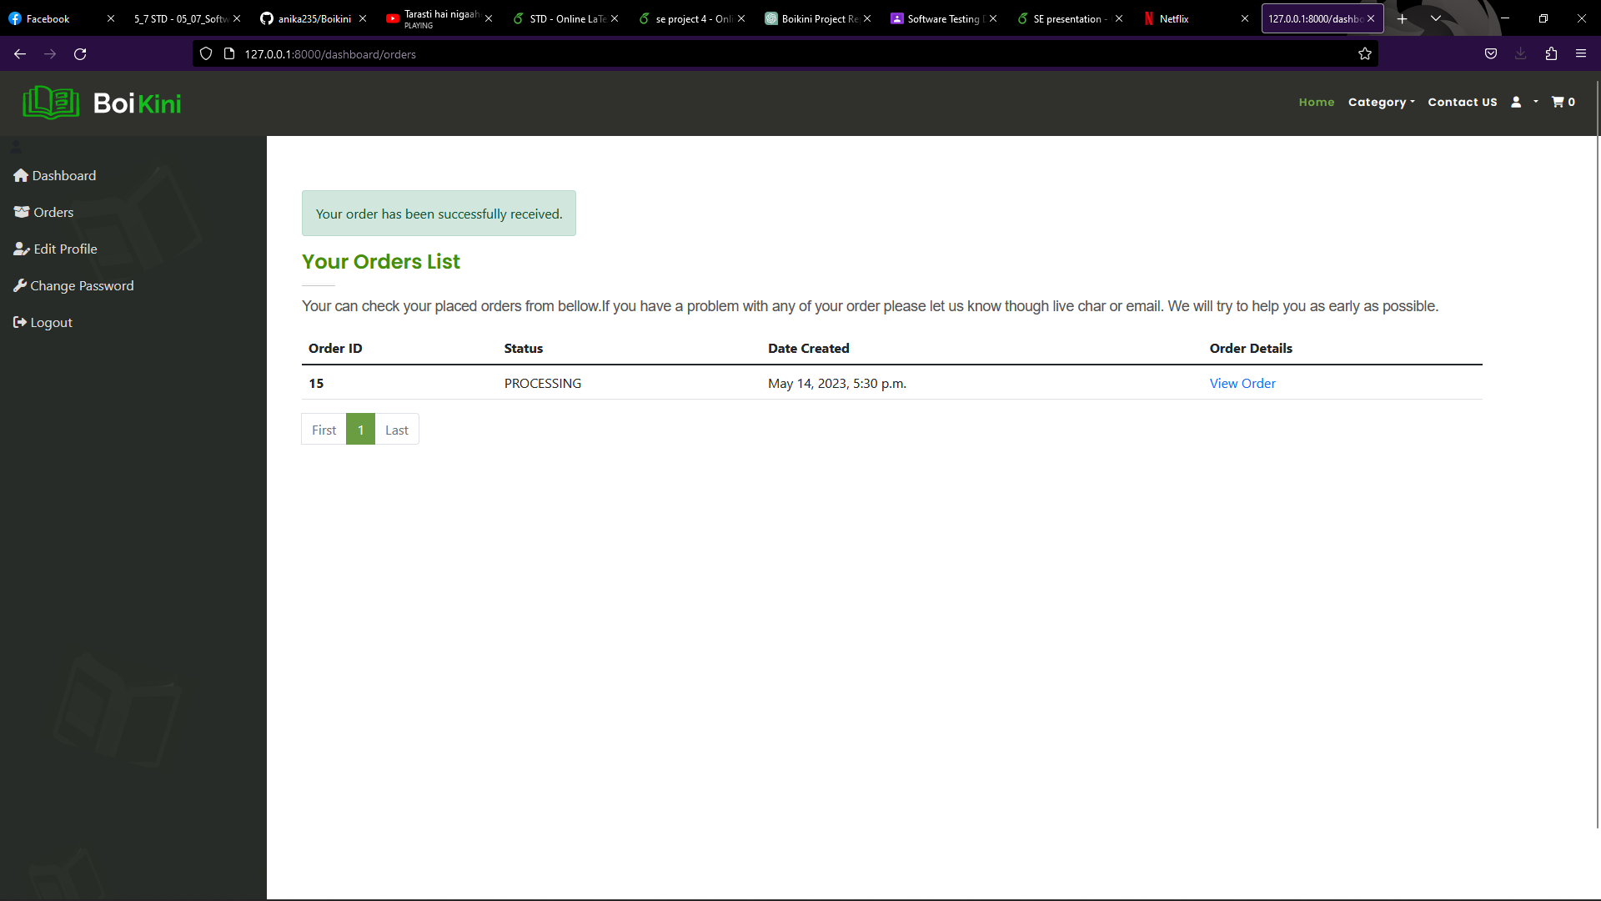
Orders
After completing the checkout successfully, orders get added to the Orders section. You can also view your other orders here.

Slide 19
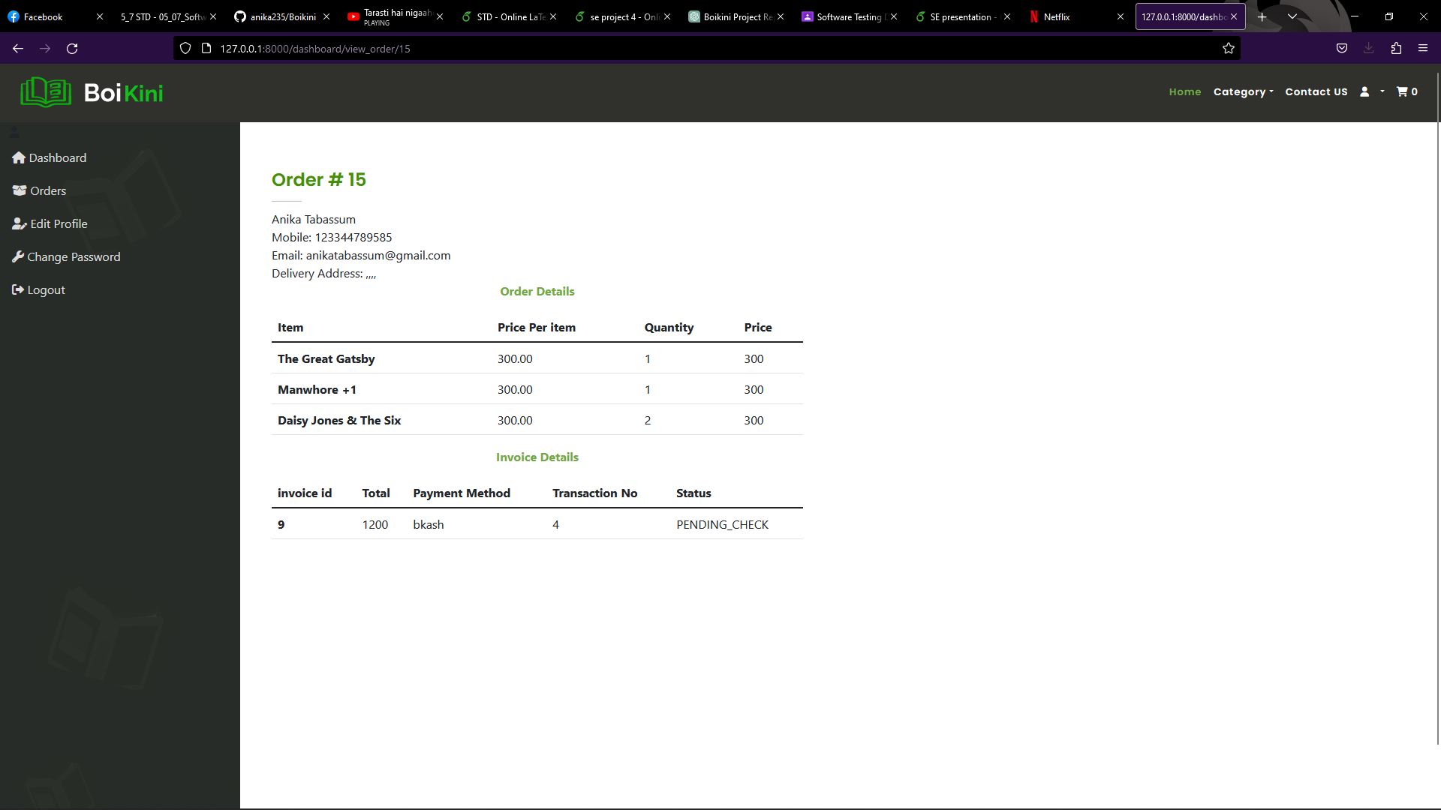
View Orders
You can view the orders and the invoice here

Slide 20
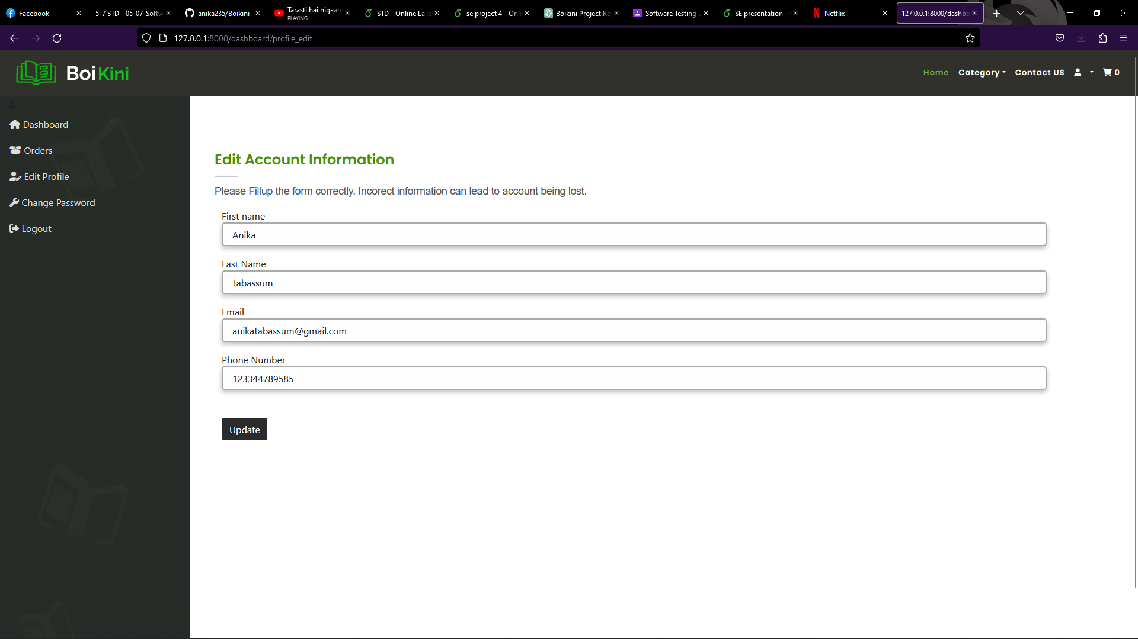
Edit Account
You can also edit your personal information.

Slide 21
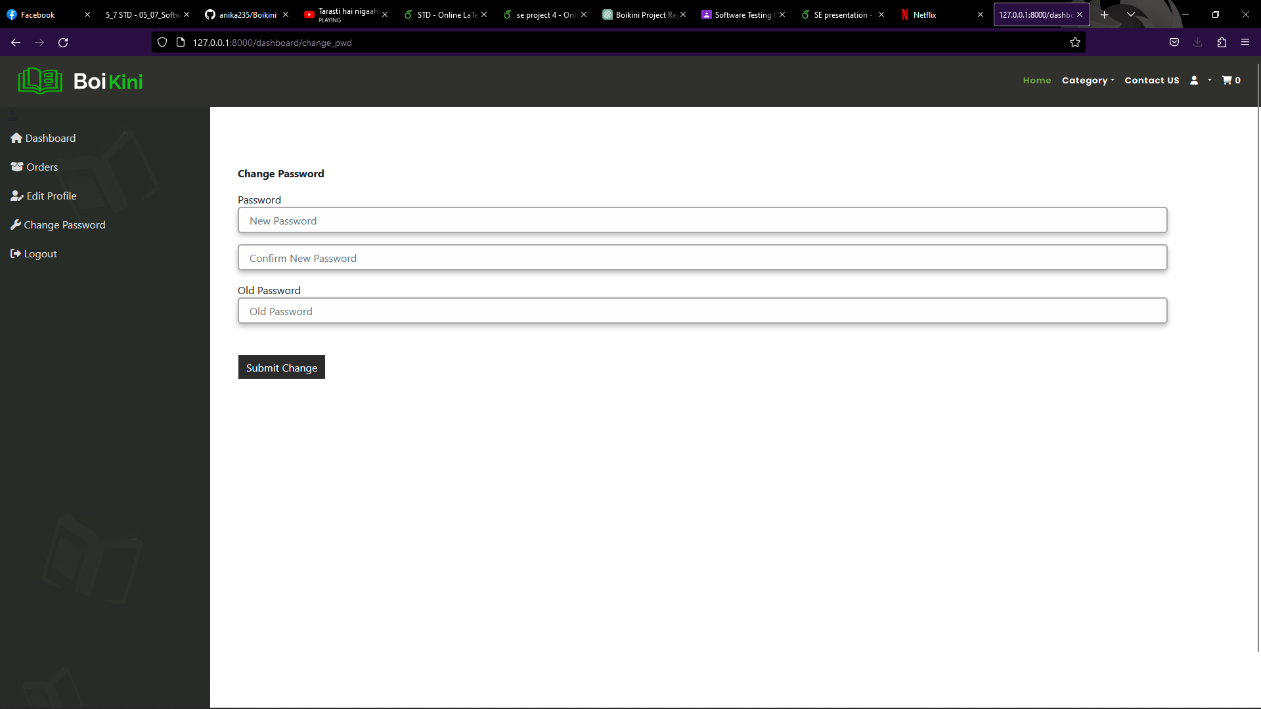
Change Password
You can change your password here.

Slide 22
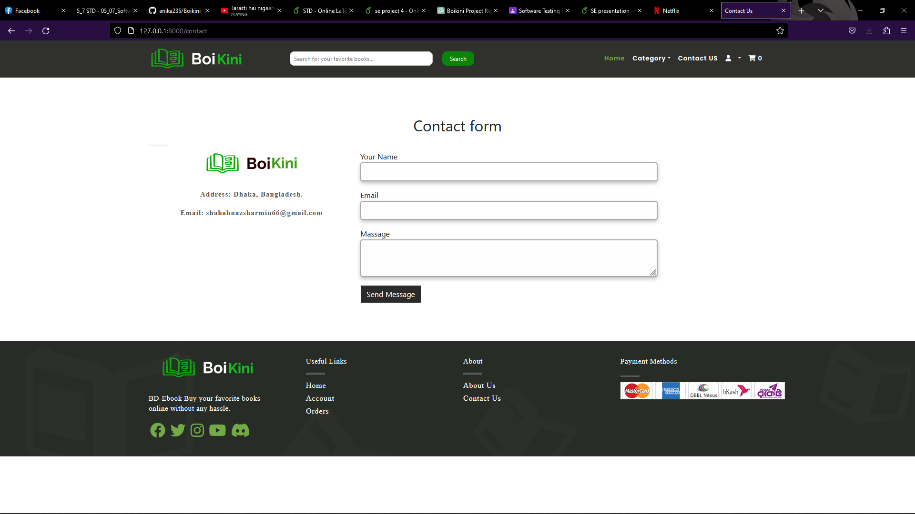
Contact us
You can contact us for any query or for sharing any problem.

Slide 23
Conclusion
Boikini is a fully functional online book shop that provides a seamless experience to book buyers and sellers. We have implemented a range of features that make it easier for users to explore and manage their books. We are continuously improving our platform based on feedback and suggestions from our users.

Slide 24
Thank You

